Slide 1
Joint Research in the EFRC
Luzi Valär
Chairman Working Group R&D
Luzi.valaer@burckhardtcompression.com

Slide 2
Introduction EFRC - Objectives
1. Knowledge transfer
Conferences
Internet
Student workshops
Training and seminars
2. Standardization work
Improve, extend and develop standards
Facilitate the process of developing international standards
3. Joint research
Pre-competitive
Aiming at improving the performance of the recip
Scientific arm of the reciprocating compressor community

Slide 3
Introduction
Pre-competitive phase
Competitive phase
IP with industry
Precompetitive character of the projects is mandatory
Deployment
Technology readiness
EFRC
Competitive R&D
Pre competitive R&D
Explorative research

Slide 4
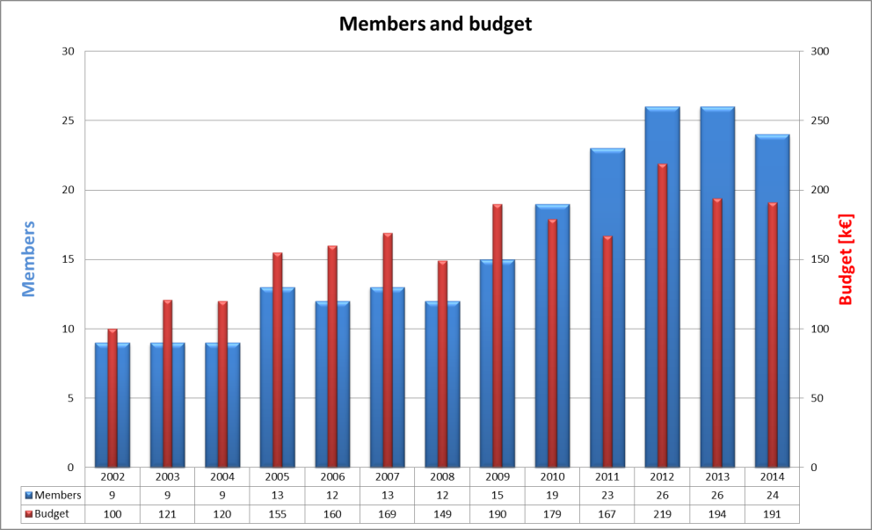
Introduction
We invest ~ k€ 200/a
To strengthen reciprocating compressor technology in comparison with other compression technologies.
For the improvement of reciprocating compressors and their components in order to give long term competitive advantages to OEM’s as well as to users.
To pool know-how from users and suppliers to establish Europe as reciprocating compressor “hot-spot”.

Slide 5
How it works
EFRC members can join the R&D Working Group
Annual budget funded by participating members
Two meetings per year (hosted by one of the members):
Status of ongoing projects
Selection of ideas
New project proposals
Selection and approval of projects
Financial status and membership fees
Results are owned by EFRC
Results are disclosed to Working Group members only

Slide 6
How it works
Interested in joining the Working Group?
Join the EFRC (fill in “Application for Membership” on EFRC website www.recip.org.
Contact the Chairman of the Working Group R&D to get an invitation for the next meeting.
Decide upon your company’s financial contribution to the Working Group R&D (from € 1’000.- to € 20’000.- depending on company size and purpose)
During the meeting members vote upon acceptance of new members to the Working Group R&D which is also dependent on the financial contribution.

Slide 7
Join the R&D Working Group and help to lead the reciprocating compressor industry in a successful future…
?

